Slide 1
HY484 Project:Terrorist Networks
Visualization of networks created by attacks by the year.

Slide 2
Project Description:
In this project we aim to identify the existence of coordinated attacks by the year and the formation of a network identifying a terrorist group. We will refer to those attacks as events and extract information from a dataset that contains reports of terrorist attacks. Our approach is divided in 3 levels:
Separation, cleanse and selection of data that will be used for the creation of the network graph.
Generation of a graph that will depict those networks, using the Tom Sawyer Perspectives Designer.
Analysis of the results and conclusions.

Slide 3
Step 1: Separation of the data
To extract useful data from our global dataset we have created a python script that selects the reports corresponding to a specific year. We will only collect reports that refer to ‘’successful’’ events, meaning that the event was not prevented. We separate our csv file in 4 sub files. Each one of them contain information about the nodes and the edges of our network. The files we create are:
year_Attacks.csv : Information about an event node
year_Cities.csv : Information about an city node where an event took place
yearAttack_Attack_Connection.csv : Information about the connection between events
yearCity_Attacks_Connection.csv : Information about the connection between an event and a city.
Where year is the specific year we examine.

Slide 4
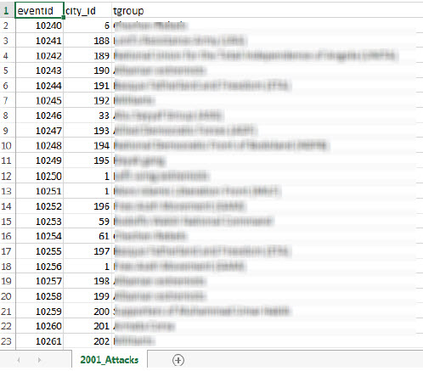
2001_Attacks.csv:
Here we will present the attributes of a node that represents an event.
Eventid: is the same unique identifier from the original dataset.
City_id: is a crafted unique identifier that corresponds to one specific city.
Tgroup: is the actual name of the group that carried out the event or claimed its responsibility .

Slide 5
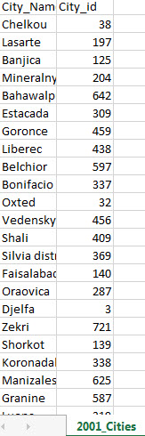
2001_Cities.csv
Here we will present the attributes of a node that represents a city where an event was carried out.
City_Name: The actual name of the city
City_id: a crafted unique identifier that corresponds to one specific city.

Slide 6
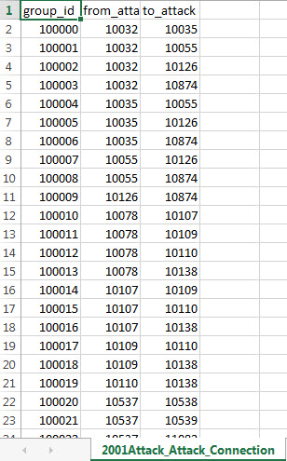
2001Attack_Attack_Connection.csv
Here we present the attributes that characterize a connection between two events. We claim that IF two events were carried out / claimed by the same group then they are connected.
Group_id: The unique id of the edge. That name has no connection with the group_id that characterizes a group.
From_attack: Τhe source node id.
Το_attack : The destination node id.

Slide 7
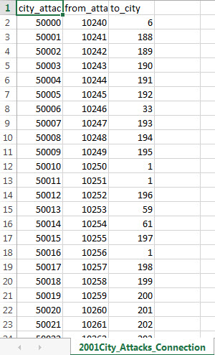
2001City_Attacks_Connection.csv
Here we present the attributes of an edge connecting a city with an event. We declare that an event is connected to a city if it took place in that specific city.
City_attack: The id of the edge
From_attack: The unique id of the event
To_city: The unique id of the city

Slide 8
Side notes:
Our python script collects data based on a specified year. Having said that we also have to mention that this script creates the 4 csv files only based on some analysis. The final dataset with the 4 sheets has to be formatted manually.
There can be added further analysis on that script. For example we could also generate connections between cities based on the country they lay on.
The analysis is documented inside the python script.

Slide 9
Results: 2001 Events
In the next figure ,we present our result. Before that we will explain a bit further what we see:
The red edges represent a connection between a city and an event.
The green edges represent a connection between two events.
The event nodes are depicted with a two-sword icon.
The city nodes are depicted with a city icon.

Slide 10
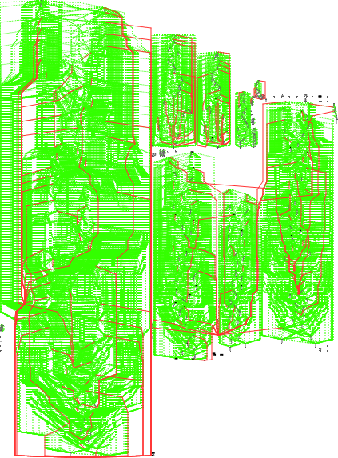
Results: Hierarchical Layout

Slide 11
Results: Hierarchical Layout
From the previous layout we can not extract useful information. The reason it the huge quantity of edges and nodes.
But , when analyzing the circular layout we can observe some interesting facts about our network.

Slide 12
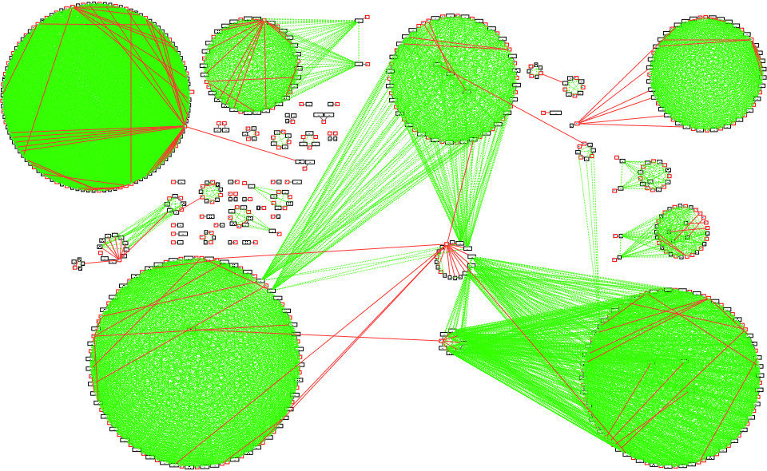
Results: Circular Layout

Slide 13
Results: Circular Layout
Let us observe some interesting facts about our graph:
The coordinated events we aimed to identify can be observed as the cycles with the green color between them. By saying that, we mean that the existence of terrorist networks surfaces in the form of cyclic graphs, where all their nodes are connected with each other.
The density of the green edges represents the lifehood of a network. Meaning that if the density inside a cycle is low , after a period of time that network was disabled or eliminated.
Before moving one with explaining our observations , let us take a closer look at our graph elements.

Slide 14
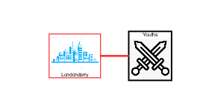
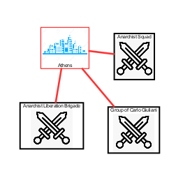
Indifferent Edges
Here we have two kinds of indifferent edges:
Isolated events that do not depict the existence of a network
Events carried out in the same city ,but from different group thus they also do not depict the existence of a network

Slide 15
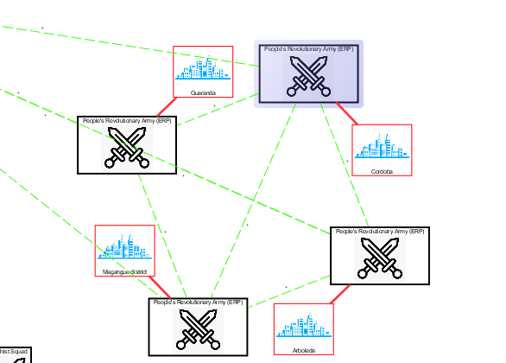
Networks surfaced:
The events carried out by the same group form a cycle, a strongly connected complete graph. In the following figure we can observe a small network as an example:

Slide 16
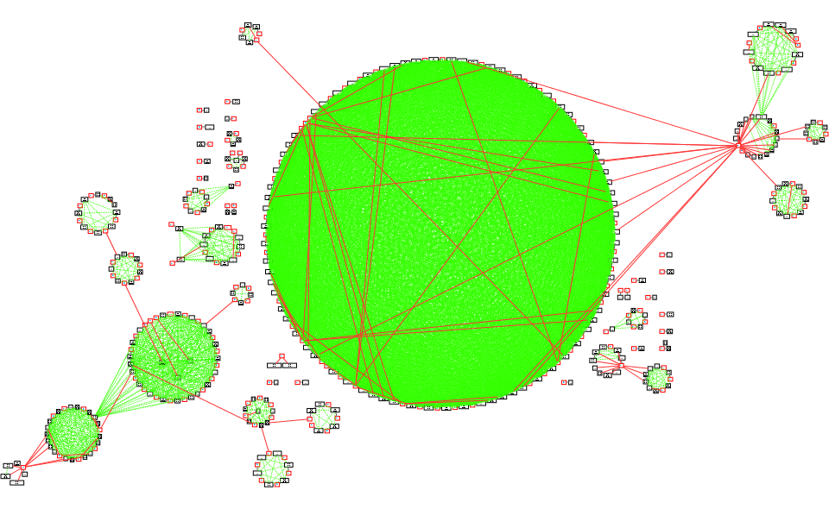
Layout of 2016:

Slide 17
Conclusions
Even though the number of cycles created between 2001(~=22) and 2016(~=21) graphs has no significant difference, the density of the green edges inside the cycle is significantly less.
That fact could be a result of two things:
The group that was carrying out those events was eliminated.
The counter terrorism measures and agencies of the countries that initially were targeted by that group , were so much improved that prevented the continuation of that group’s actions.
Moreover, if the density of a cycle decreases with the passage of time , then it is safe to assume that next year the cycle created by that group will not be shown in the graph (based on the above observation).

Slide 18
Conclusions
As we previously mentioned , the density of the green edges inside a cycle (comparing the 2001 to the 2016 graphs) is decreasing. This means that the counter terrorism measures and agencies of the countries are improved by the year.
Finally, by observing the 2016 graph ,we can see that the density of the green edges in a cycle could be caused by the foreign or domestic policy of a country toward the country that ‘’roofs’’ a group. For example an aggressive foreign policy of a strong nation ,let us say A, towards a smaller one where a group is being located will cause the creation of a cycle by that group around the cities of the nation A.

Slide 19
Thank you for your time
csd3805

